Slide 1
Miller NVC
Workshop
Prof Tom Peterson, Jacob Hicks
February 18, 2014

Slide 2



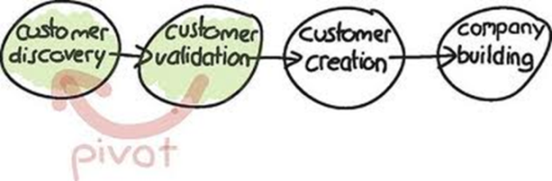
New Venture Startup Execution Model
Investor Day
Oct 1
Investor Day
Oct 4
Stage 1: Idea Formulation
(Sep 1 – Oct 15)
Stage 4: Summer
Skills Accelerator
(May 15 – Aug 15)
Scale
Idea
Launch
Model
Stage 3: Scaling Plan,
Miller New Venture Challenge
(Feb 15 – April 1)
Stage 2: Business Model
Development & Validation
(Oct 15 – Feb 15)

Slide 3
T
“EXECUTE” means
DO IT
“IDEA”
really means
INNOVATE
“PLAN” means
FORECAST
“MODEL” means VALIDATE

Slide 4
IDEA
Principles of Innovation:
- Innovators DNA
- Idea Generation and Development
Initial Pain or Problem Statement
Initial Solution
- Early Hypothesis
- List of Early Assumptions
Differentiation
Execute
MVP
Plan
Model
MVP

Slide 5
MODEL
Execute
Idea
MVP
Testing & Validation
- Vetting hypothesis thru
Interviewing customers,
Partners, vendors, etc.
Multiple Iterations of
Learning & Pivoting
Evidence of Validation
Work Papers
Initial IP
Plan
MVP

Slide 6
FORECAST for SCALE
Final Draft of Executive Summary
Execute
Idea
Finished Pain
Finished Solution
Business Model Progress/Results
Underlying Technology (Secret Sauce, Blue Ocean, Disruption)
Competitive Analysis
Validated Revenue Streams
Validated Marketing & Sales Plan
Leadership Team (Qualifications)
Financial Summary*
- Income projections w/ validated assumptions
- Cash flow projection w/ validated assumptions
- Projected cash requirements, timing
10. Milestones, Current Status, and Scaling
11. Draft Executive Summary
Model
*Projections and funding requirements
have been validated in BMD and
extrapolated accordingly.
**Milestones prove current market traction, current state of the company, and next steps for scaling.

Slide 7
EXECUTE
1. Legal Work
- Articles of Incorporation
- Shareholder Agreement
- CAP Table
- Non Competes, Confidentiality, etc.
2. Team Building & Development
3. Scaling Plan Execution
4. Fund Raising
- F&F, Accelerator, Seed Funds, VC’s
5. Leadership & Culture Development
Idea
Model
Plan

Slide 8
MARKET QUESTIONS
How big is the Total Addressable Market or (“TAM”), where will you start (“SAM”) and what is your sales closing ratio (historical or industry norms)?
  TAM = Your Total Available or Addressable Market (everyone you wish to reach with your product.)
  SAM = Your Segmented Addressable Market or Served Available Market (the portion of TAM you will target.)
  SOM = Your Share of the Market (the subset of your SAM that you will realistically reach in the first few years.)
What actions or steps will you take to acquire new customers and what is the average “cost of acquisition” per customer (are costs variable or fixed)?
How fast (in % terms) have comparable companies in your industry grown and what is your estimated growth rate? What is the Compound Annual Growth Rate (“CAGR”) expected in your industry in the next 5 years?
Who is on your Advisory Board to help you navigate the competition?
What are the 2-3 biggest competitive weaknesses/obstacles and what is your plan to overcome them?
What is your Value Proposition? In other words, what are the main reasons customers will buy your product or service?

Slide 9
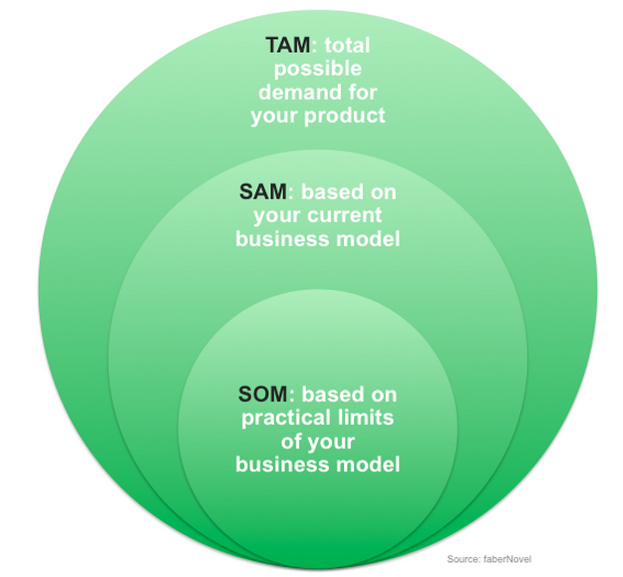
Define Your Market TAM, SAM, SOM
Total Addressable Market
Segmented Addressable Market
Share
Of
Market

Slide 10
FINANCE QUESTIONS
What are the assumptions behind your 5-year revenue forecast (# of customers, revenues per customer, customer segments, etc.)?
When will you break-even and what happens if it takes you 2x longer than you expected?
How did you arrive at the price of your product or service?
What is your expected “burn rate” per month and for the first year?
How did you determine your total variable and fixed costs (was it through Research? Due diligence? Bids)?
How much capital do you need? See: http://www.youtube.com/watch?v=bYc2qPr_MUU
What is your break-down of "Use of Funds"...how do you plan to grow your business?
What does your Capital Table (ownership %) look like? Cap Tables: See: http://www.youtube.com/watch?v=OVJfOC93mSM

Slide 11
CET Getting Started Videos
Cap Tables: http://www.youtube.com/watch?v=OVJfOC93mSM
Why Go Into Business: http://www.youtube.com/watch?v=idZZjNMpcvw
Is Entrepreneurship for me?: http://www.youtube.com/watch?v=AiujlTiNOP4
Term Sheets: http://www.youtube.com/watch?v=9KoD7WUv1V8
Pre-Money Valuation: http://www.youtube.com/watch?v=bYc2qPr_MUU
Start with the End in Mind: http://www.youtube.com/watch?v=47PDlqN8mKE
Early Funding: http://www.youtube.com/watch?v=o6kt5prPVSk
Convertible Debt: http://www.youtube.com/watch?v=X6PG9C-XkHM
Operating Agreements: http://www.youtube.com/watch?v=w1Fx7s_4oqU

Slide 12
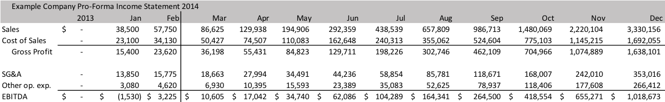
Monthly Financial Forecasting
Explanation of Financial Inputs
Sales
January and February sales figures are the result of 70 and 105 units sold respectively at an average unit price of $550. Future sales projections assume this 50% growth rate month by month.
Cost of Sales
The units cost 60% of our sales price, resulting in an initial 40% gross margin. With our projected volume, our suppliers indicate that our unit cost will decrease by 1.5% each month for at least the next 10 months. By December, our gross margin is projected to be 49%.
SG&A
Per our online marketing agreements and our first two months of operations, our advertising and promotion costs are nearly 10% of sales. We applied this percentage to projected sales to determine our growing advertising costs. Our payroll is already established based on our founders’ salary needs. Payroll has started at $10,000/month, will jump to $15,000/month in April, and will jump again to $20,000/month in August. This projection will also enable us to hire two part-time (20 hours/week) employees at a company cost of $18/hour as early as April.
Other Operating Expenses
Our fulfillment center will charge us 5% of sales per our agreement valid through February 2015. Additionally, shipping is projected as 2% of sales and miscellaneous items are factored to cost 1% of sales. These percentages have been applied for each month of the remainder of the year.

Slide 13
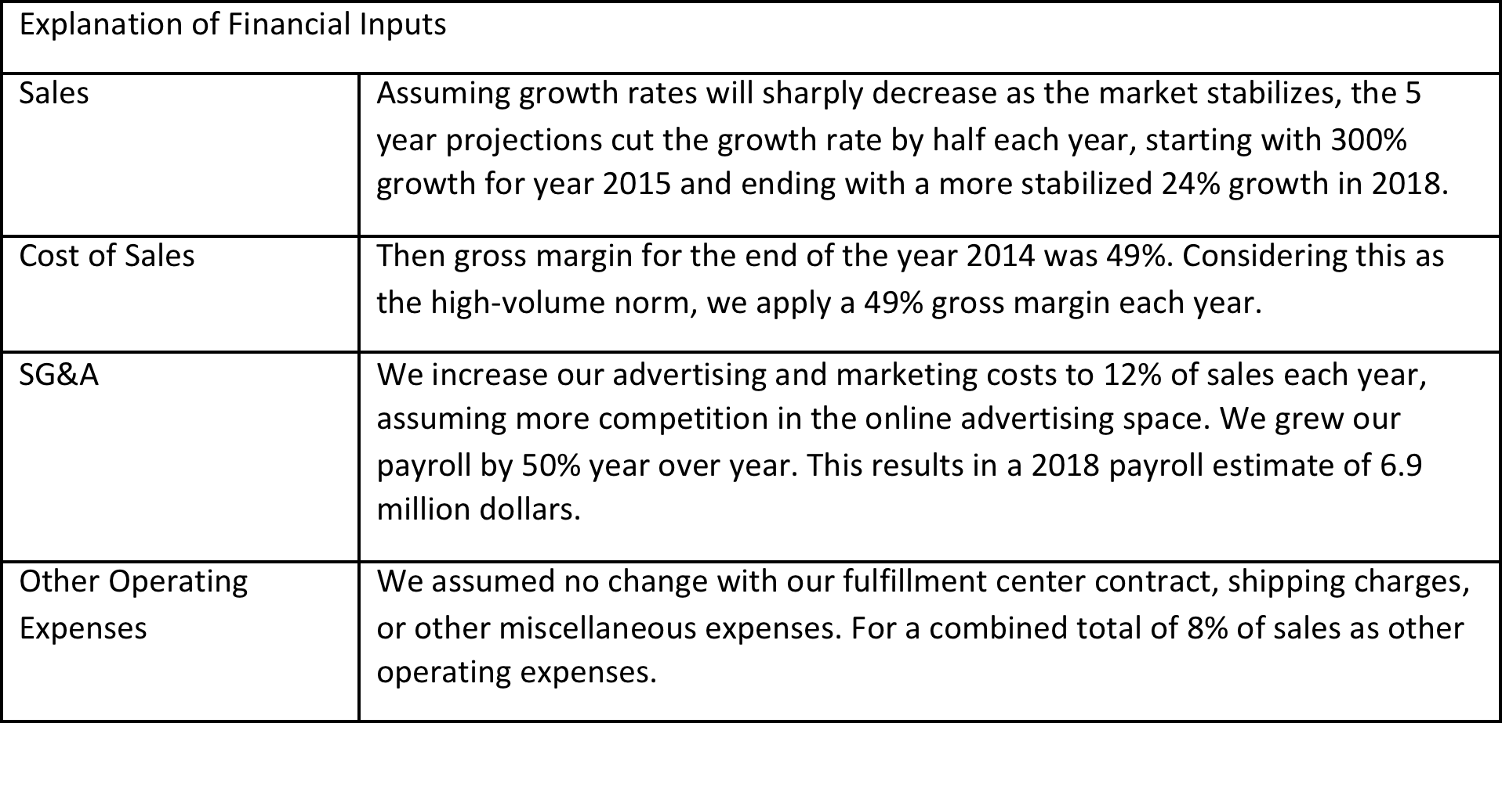
Annual Financial Forecasting

Slide 14
Thank you for your attendance and best of success in the competition.
Questions?
Miller NVC
Workshop
Prof Tom Peterson and Jacob Hicks
February 18, 2014

